Slide 1


Slide 2
Backend implementation using stack of Microsoft technologies for mobile apps
Oleksandr Krakovetskyi
CEO, DevRain Solutions
@msugvnua, alex.krakovetskiy@devrain.com

Slide 3
ASP.NET MVC Tools
responsive template with jQuery, Modernizr
Nuget / package manager
MvcScaffolding / scaffolding, T4, code generating
SignalR / real time processing
OAuth authorization / Twitter, Facebook, Yahoo!, Windows Live, Google

Slide 4
Web service (asmx)
[WebService(Namespace = "http://tempuri.org/")]
[WebServiceBinding(ConformsTo = WsiProfiles.BasicProfile1_1)]
[System.ComponentModel.ToolboxItem(false)]
// To allow this Web Service to be called from script,
// using ASP.NET AJAX, uncomment the following line.
// [System.Web.Script.Services.ScriptService]
public class WebService1 : System.Web.Services.WebService
{
[WebMethod]
public string HelloWorld()
{
return "Hello World";
}
}

Slide 5
WCF service
// NOTE: You can use the "Rename" command on the "Refactor" menu to change the
// interface name "IService1" in both code and config file together.
[ServiceContract]
public interface IService1
{
[OperationContract]
void DoWork();
}
<service name="My.Service">
<endpoint binding="basicHttpBinding" contract=“My.IServices"></endpoint>
</service>

Slide 6
ASP.NET MVC
public ActionResult Foo()
{
var model = new MyViewModel {
Foo = 123,
Bar = "abc"
};
return Json(model, JsonRequestBehavior.AllowGet);
}

Slide 7
ASP.NET MVC – Web API
namespace HelloWebAPI.Models
{
public class Product
{
public int Id { get; set; }
public string Name { get; set; }
public decimal Price { get; set; }
}
}
namespace HelloWepAPI.Controllers
{
public class ProductsController : ApiController
{
readonly Product[] _products = new[]
{
new Product { Id = 1, Name = "Tomato Soup", Price = 1 },
new Product { Id = 2, Name = "Yo-yo", Price = 3.75M },
};
public IEnumerable<Product> GetAllProducts()
{
return _products;
}
public Product GetProductById(int id)
{
var product = _products.FirstOrDefault(p => p.Id == id);
if (product == null)
{
throw new HttpResponseException(HttpStatusCode.NotFound);
}
return product;
}
}
}

Slide 8
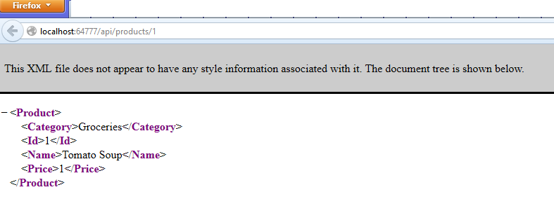
ASP.NET MVC – Web API
Controller Method | URI
GetAllProducts | /api/products
GetProductById | /api/products/id
{"Id":1,"Name":"Tomato Soup","Category":"Groceries","Price":1.0}

Slide 9
ASP.NET MVC – Web API
URI | HTTP Method | Action
/api/products/ | POST | 405 Method Not Allowed
/api/users/ | GET | 404 Not Found
/api/products/abc | GET | 400 Bad Request
/api/{controller}/{id}

Slide 10
Demo

Slide 11
Q&A
Oleksandr Krakovetskyi
CEO, DevRain Solutions
@msugvnua, alex.krakovetskiy@devrain.com

